Slide 1
Automated News Broadcasting Channel

Slide 2
Group Members
FYP – CS04 (Section A)
Yusra Masood (18B-093-CS)
Rushan Rafiq (18B-087-CS)
Yumna Asim (18B-047-CS)
Shiza Khan (18B-130-CS)

Slide 3
Introduction
The idea behind this project is to automate the process of news reporting channel by creating a web app which would aggregate the news from different news reporting websites (by scrapping data from it), filter & summarize that data and then present it.

Slide 4
POC

Slide 5
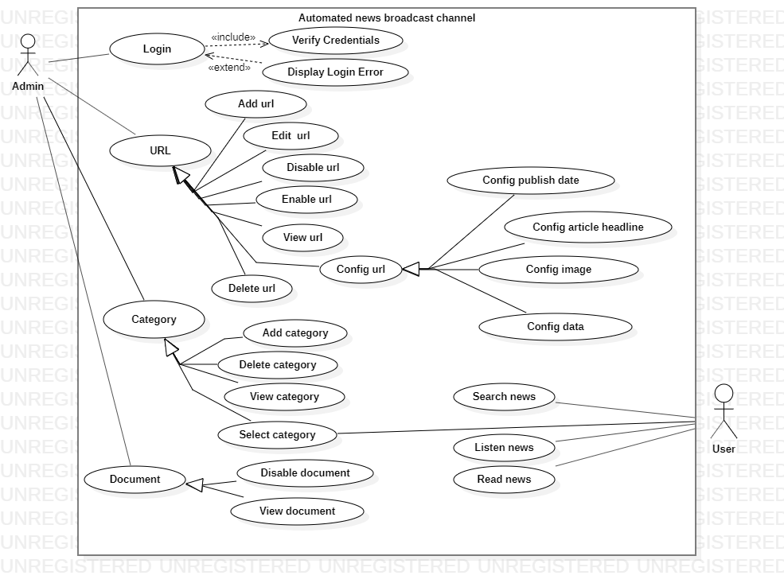
Use Case Diagram

Slide 6
Actor: Admin

Slide 7
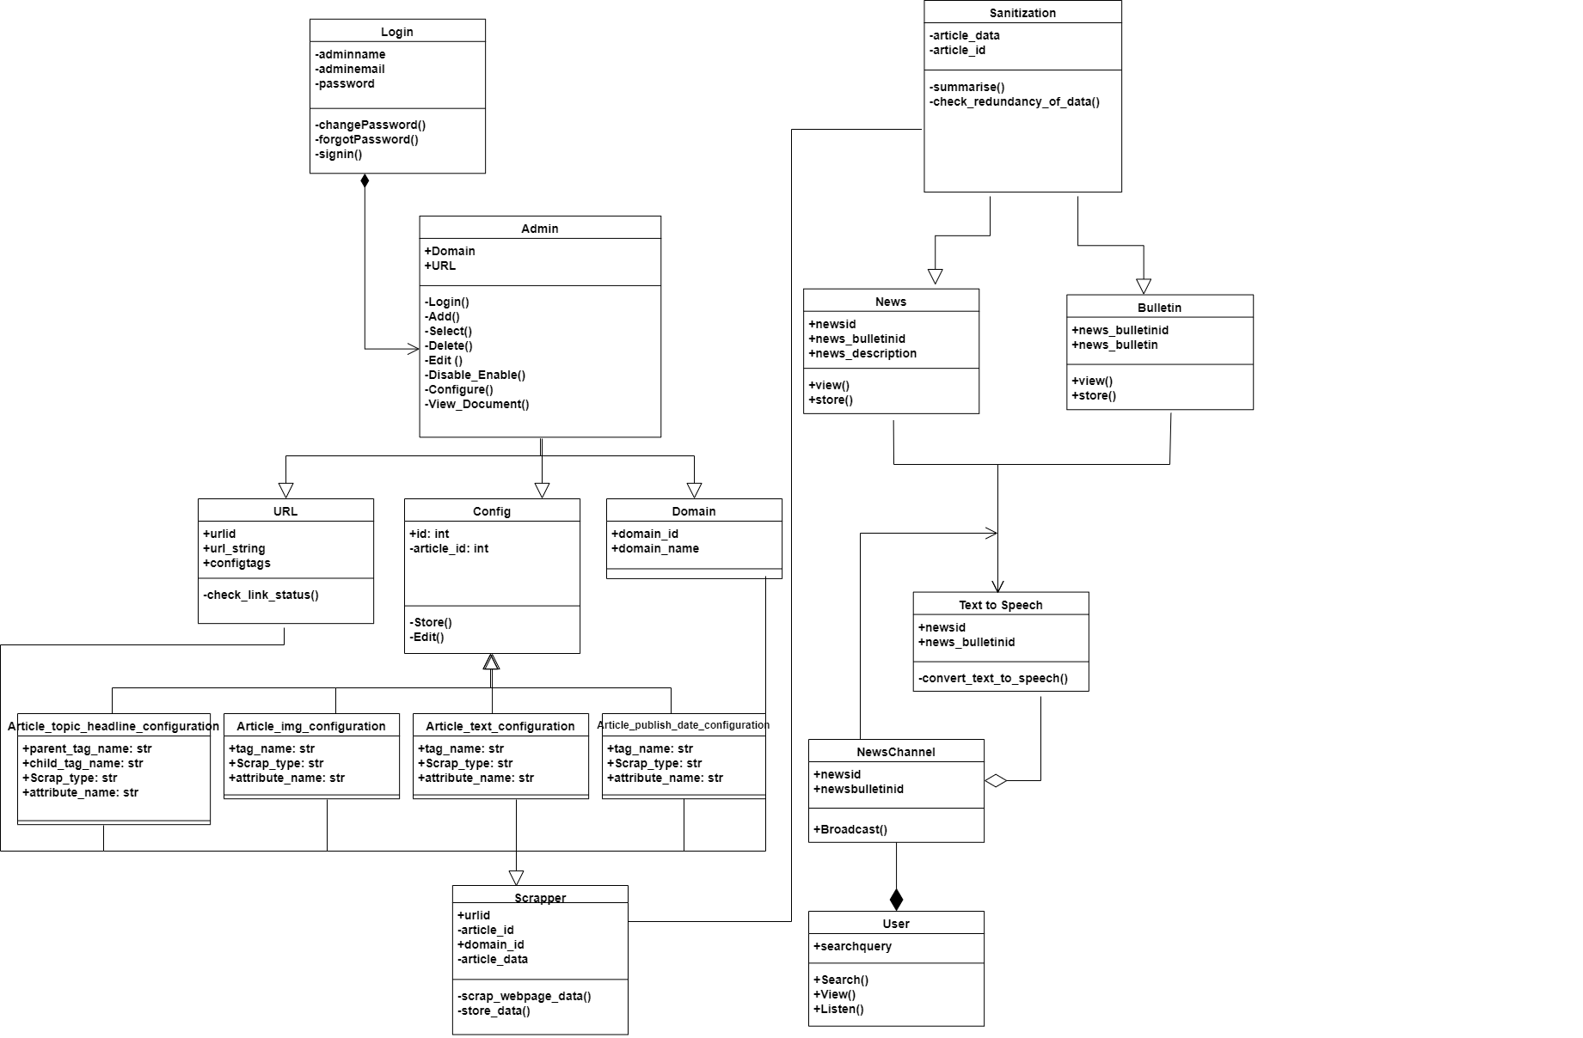
Class Diagram

Slide 8
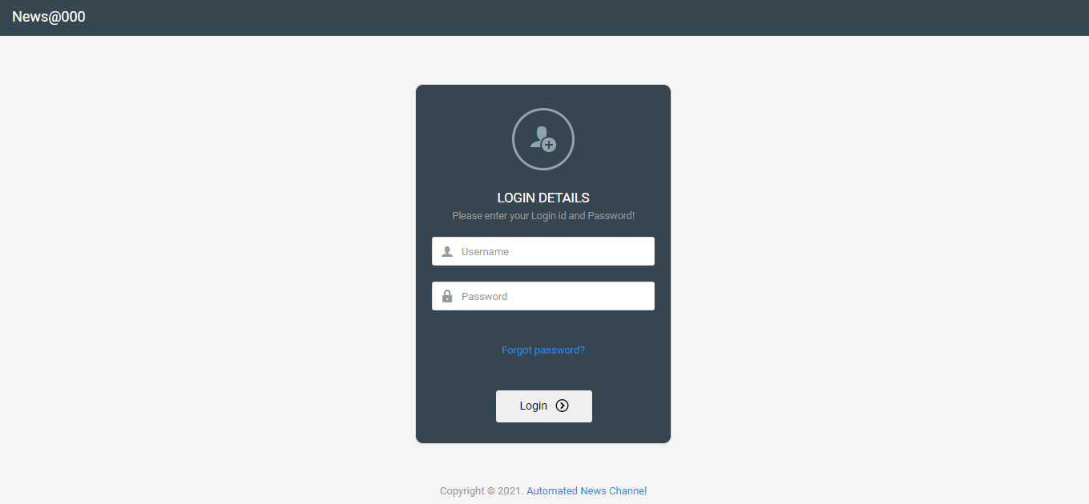
Front End

Slide 9
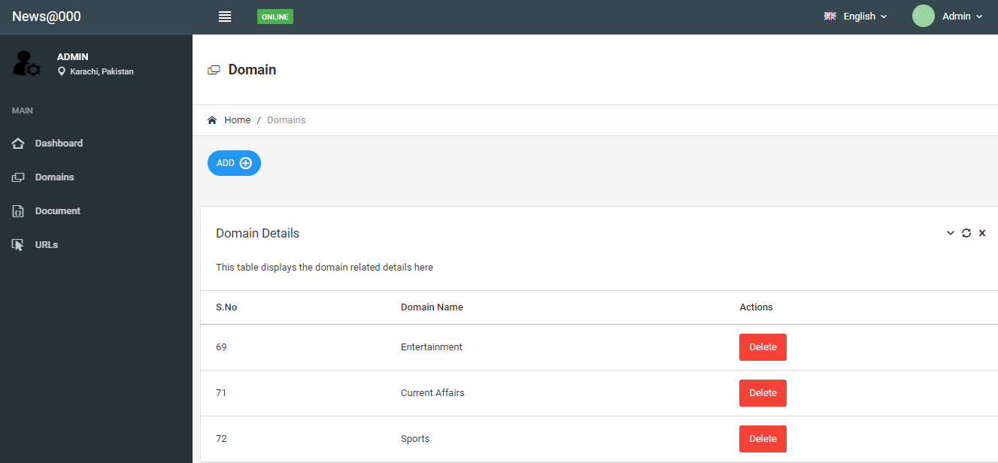
Front End

Slide 10
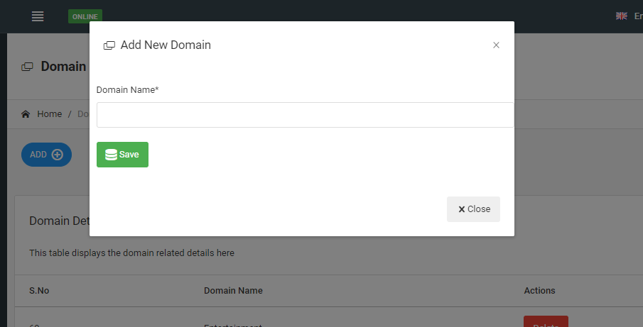

Slide 11
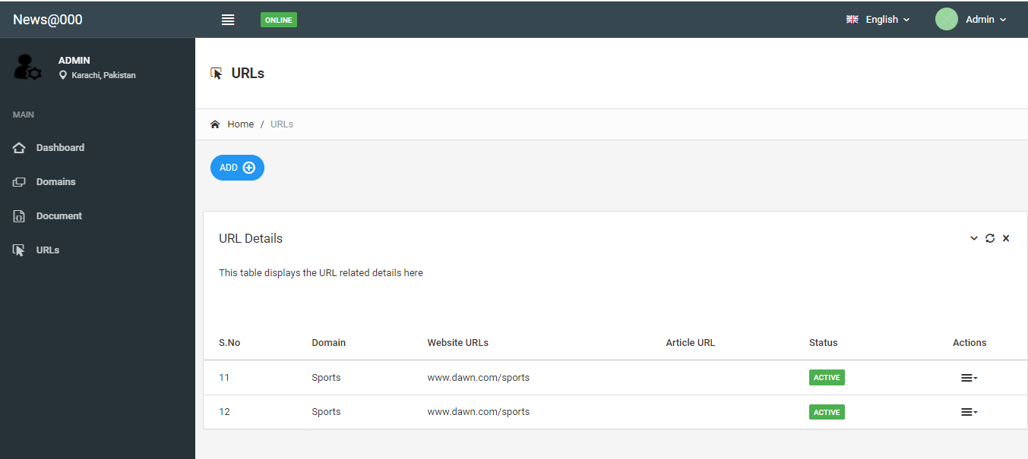
Front End

Slide 12
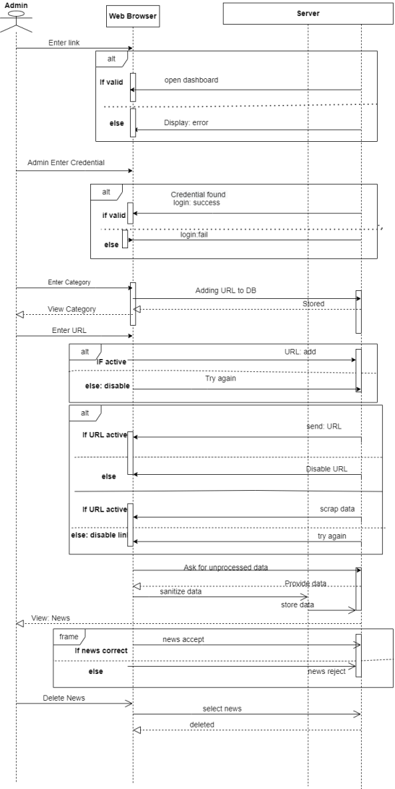
Sequence Diagram

Slide 13
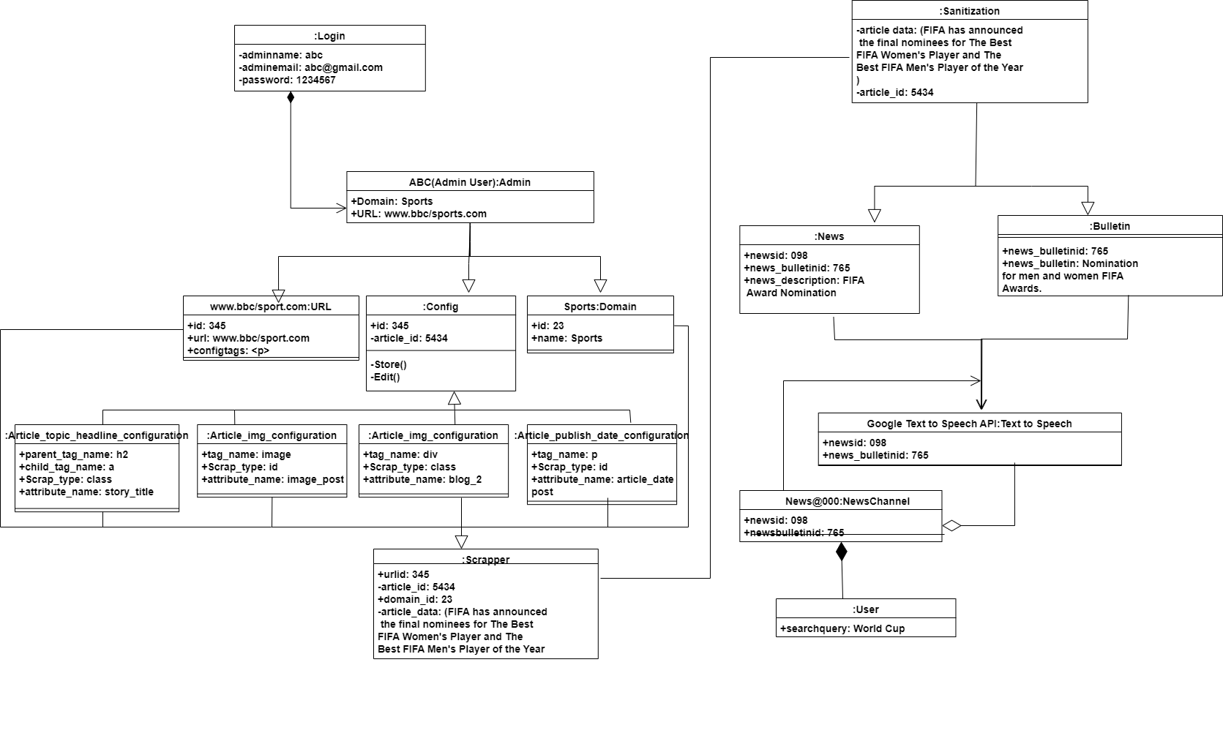
Object Diagram

Slide 14
Actor: User

Slide 15
Class Diagram

Slide 16
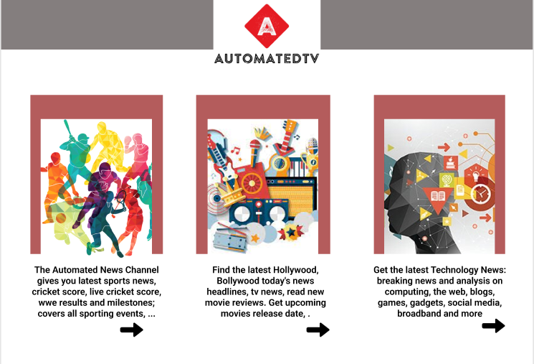
Front End

Slide 17
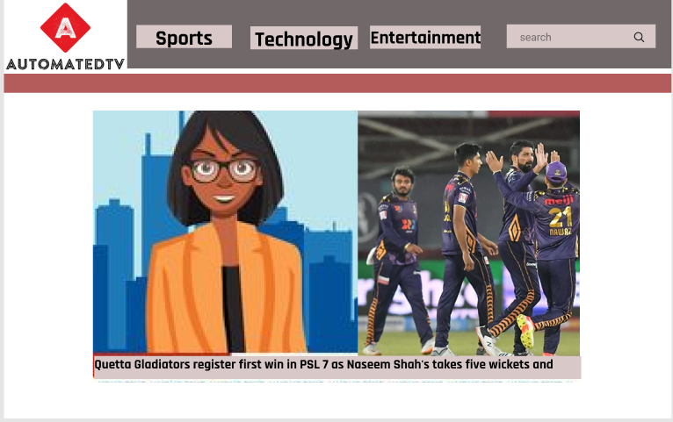
Front End

Slide 18
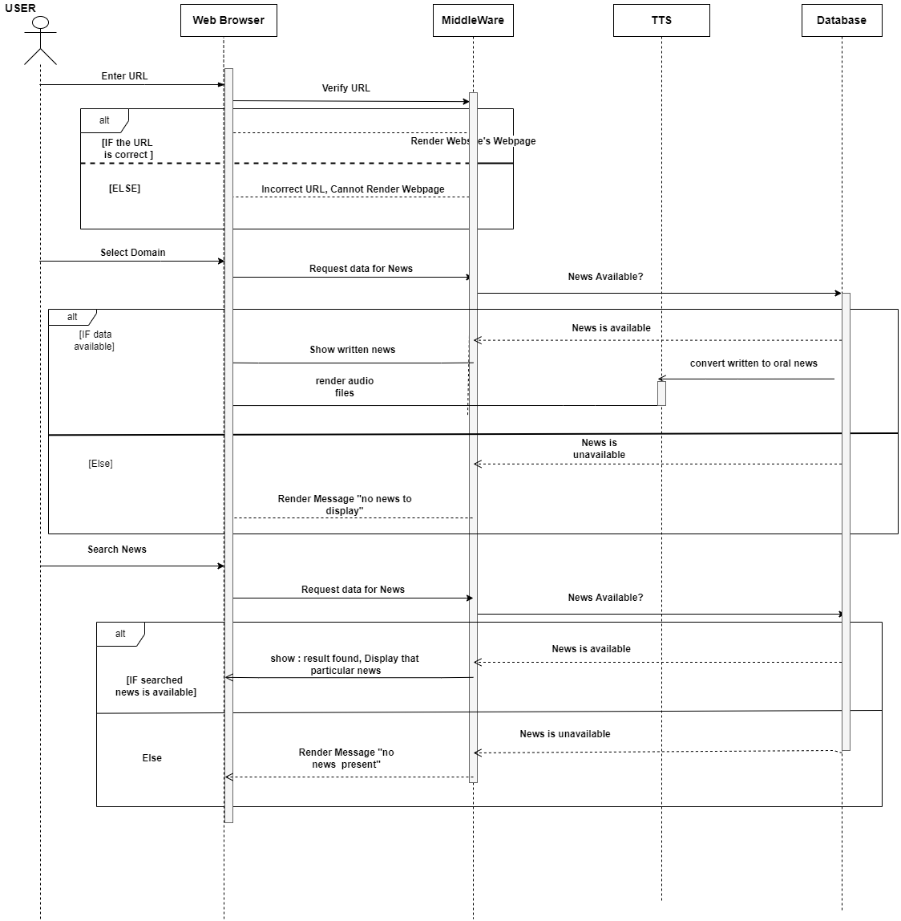
Sequence

Slide 19
Object Diagram

Slide 20
Class Diagram

Slide 21
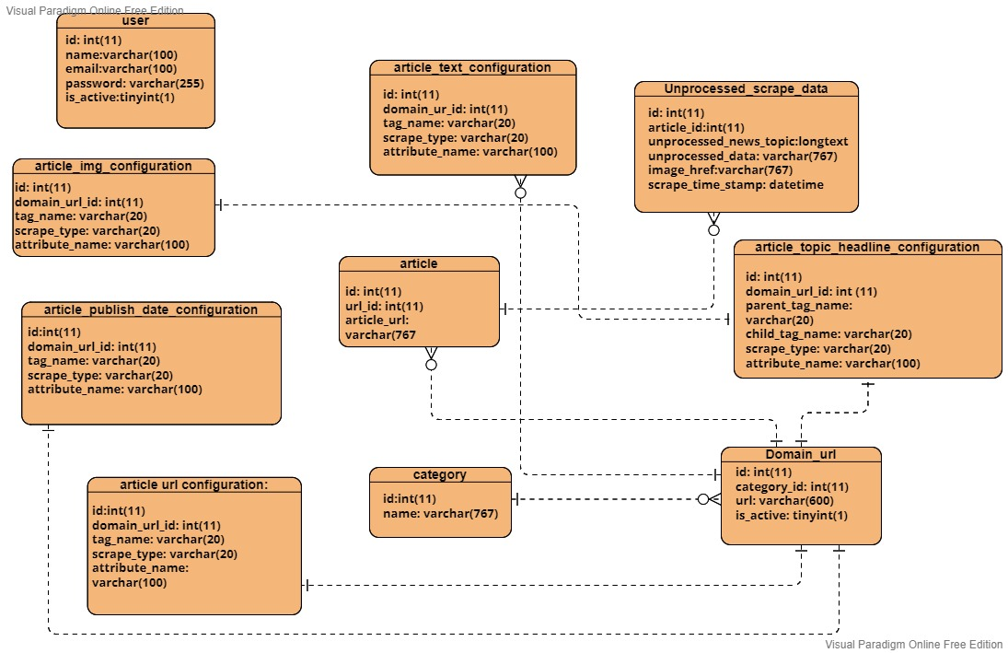
ERD Diagram

Slide 22
Algorithms
For creating this system, we have divided it into 3 subtasks :
Scrapper (Implementation done)
Text Summarization (Study/implementation in progress and is subject to changes)
Text To Speech

Slide 23
Scrapper
Link: https://github.com/yusrraa/AutomatedNewsAgency

Slide 24
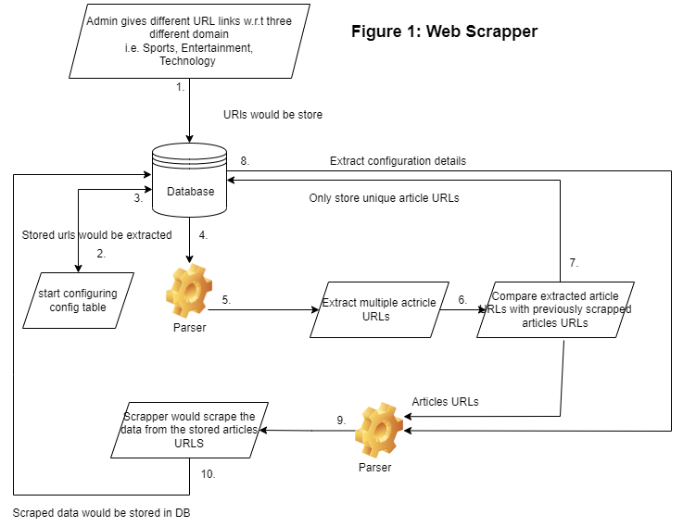
Scrapper

Slide 25
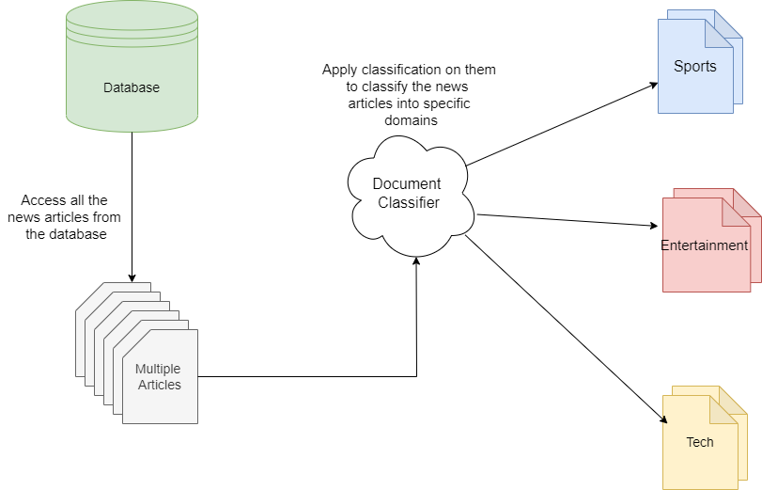
Classification of the articles

Slide 26
Text Summarization
Main Research Papers
Research Paper 1: Awasthi, Ishitva, Kuntal Gupta, Prabjot Singh Bhogal, Sahejpreet Singh Anand, and Piyush Kumar Soni. "Natural Language Processing (NLP) based Text Summarization-A Survey." In 2021 6th International Conference on Inventive Computation Technologies (ICICT), pp. 1310-1317. IEEE, 2021.
Research Paper 2: AUTOMATIC TEXT SUMMARIZATION USING DEEP LEARNING Keerthana P1 1 PG Student, Department of Computer Science, Dr.N.G.P Arts and Science College, Tamil Nadu, India
Research Paper 3: SurveyonAutomaticTextSummarization LiJinpeng １,２,ZhangChuang １,ChenXiaojun１,HuYue１,２,andLiaoPengcheng １,２

Slide 27
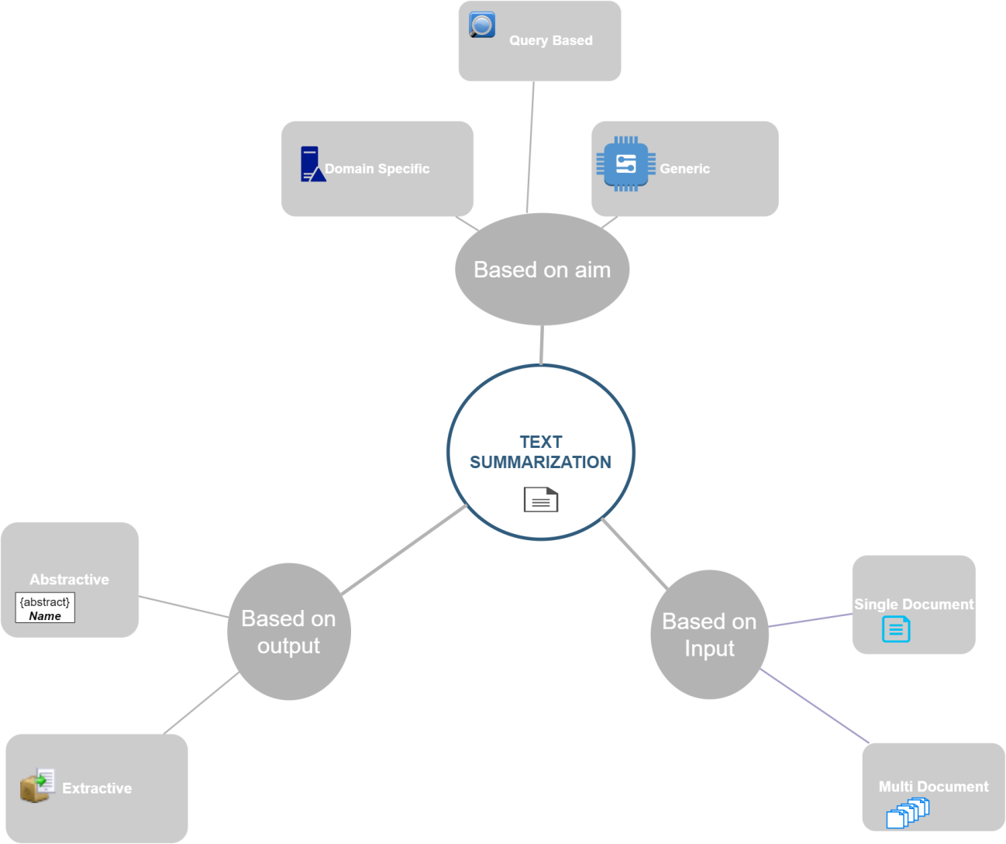
Text Summarization

Slide 28
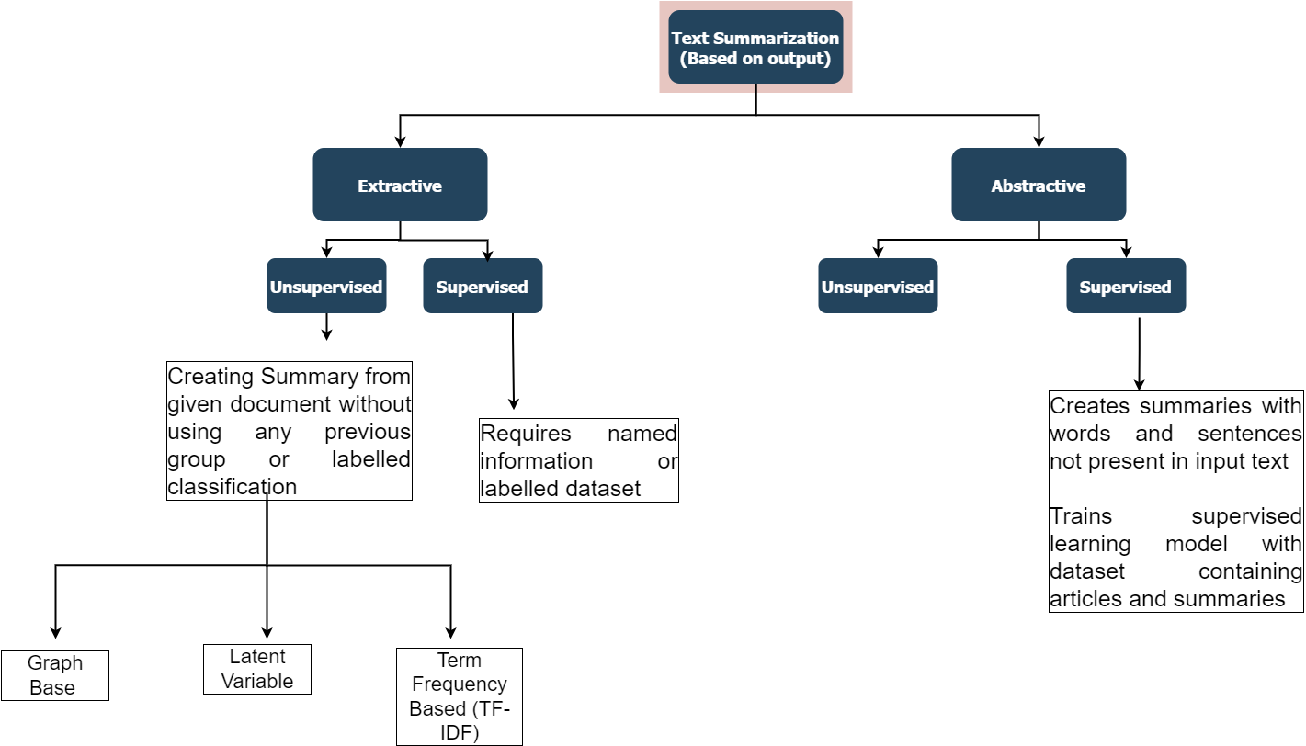
Text Summarization

Slide 29
Extractive Un-Supervised

Slide 30
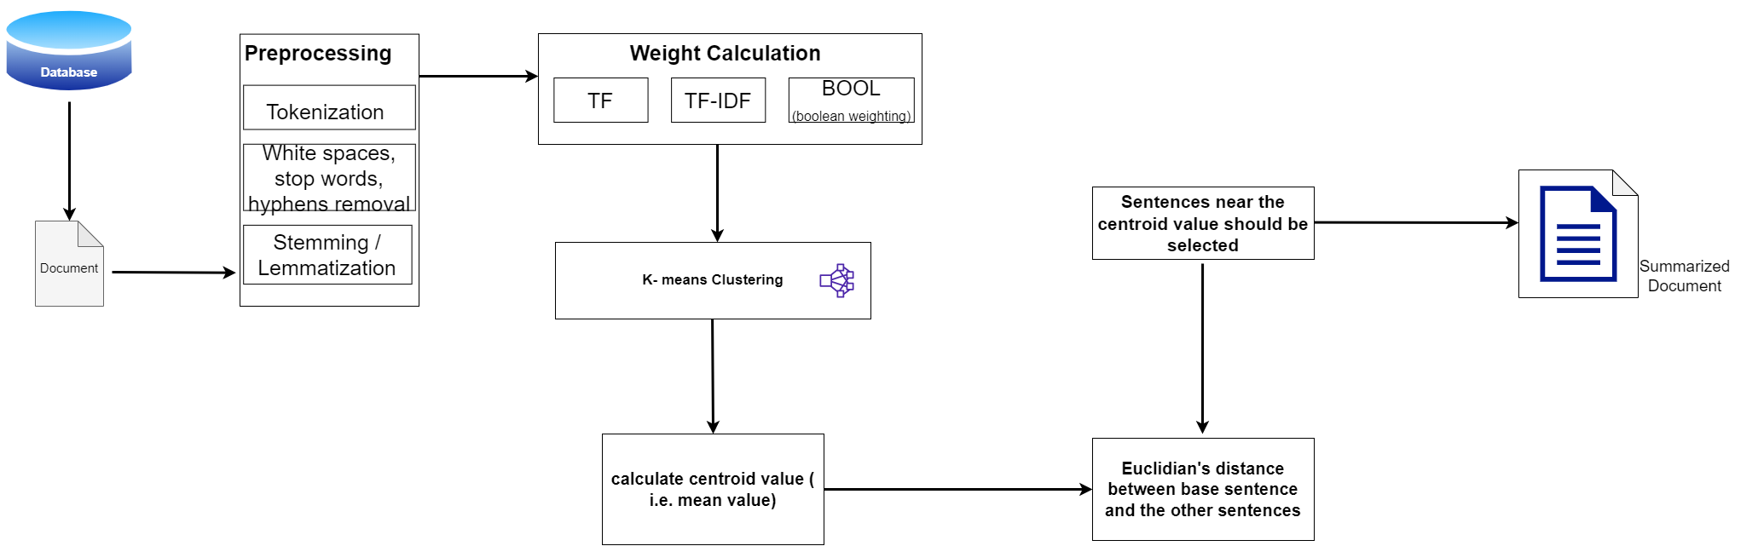
Method 1: Generalized method

Slide 31
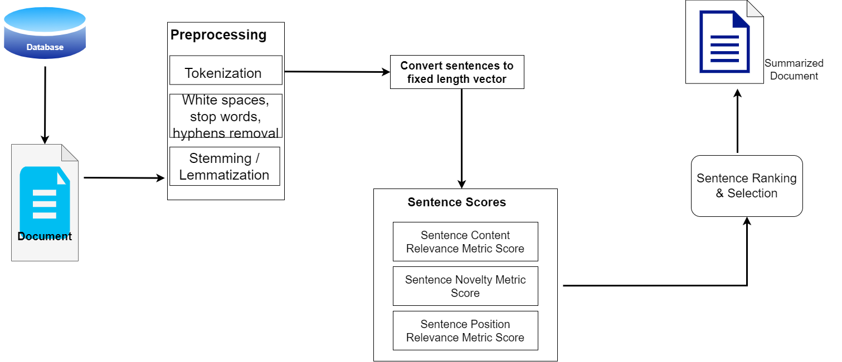
Method 2: SummCoder

Slide 32
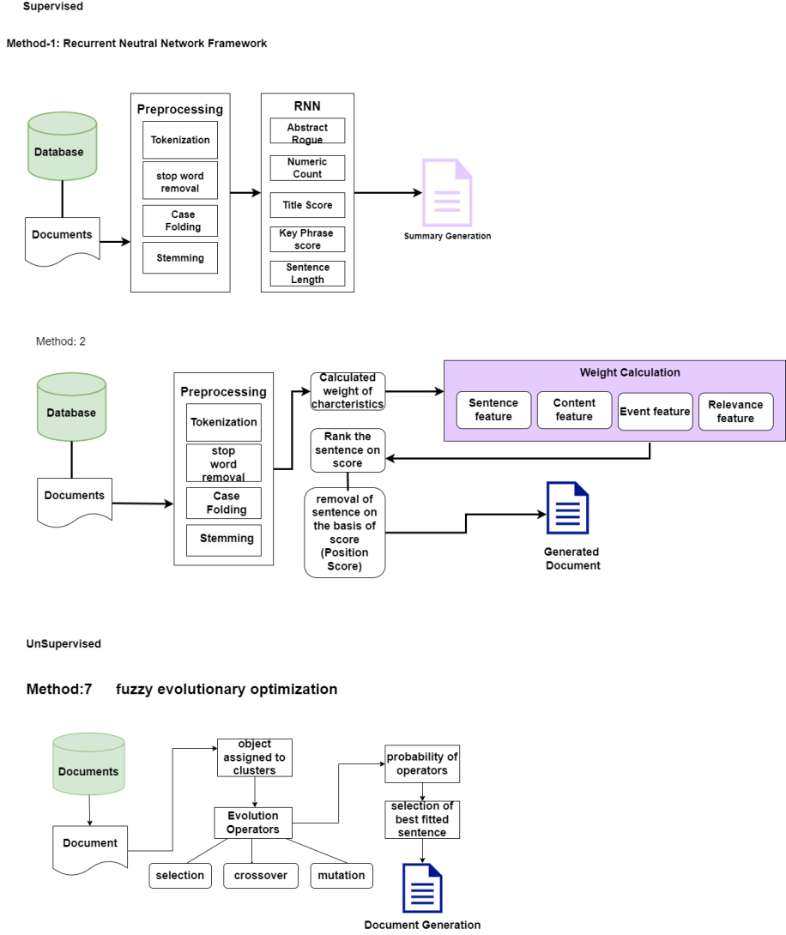
Method 3: Fuzzy Evolutionary Optimization Modelling

Slide 33
Extractive Supervised

Slide 34
Method 1: Recurrent Neural Network

Slide 35
Method 2: Characteristics Count

Slide 36
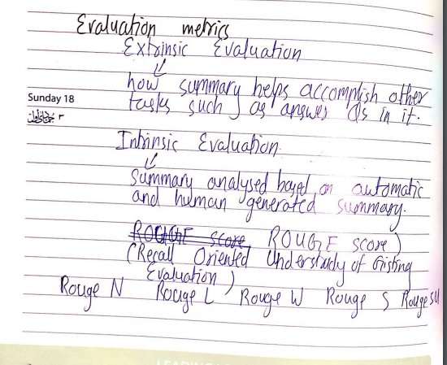
Comparison

Slide 37
TTS
Link: https://github.com/yusrraa/AutomatedNewsAgency

Slide 38
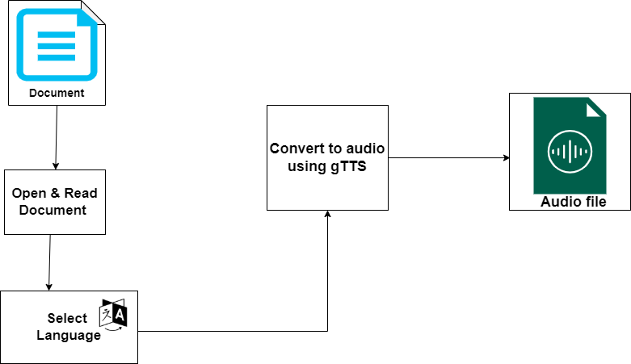
Text To Speech

Slide 39
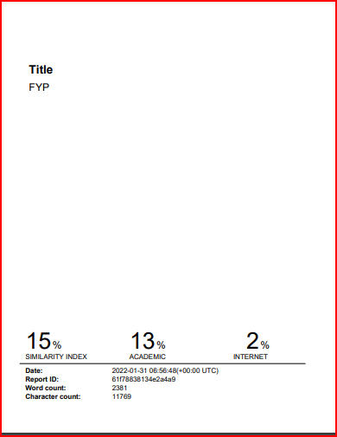
Plagiarism Report

